Slide 1
“And the Survey Says…”
Insights from the Synod Surveys
Cindee Case, Director, Office of Youth and Young Adult Ministry
Fr. Chris Luoni, Director, Office of Vocations,
Pastor, St. Joan of Arc Parish, Streetsboro

Slide 2
Workshop Description: Over the summer, high school teens, young adults, their parents and parish leaders were invited to participate in surveys to provide input to the diocese, United States Conference of Catholic Bishops and the Vatican in preparation for the 15th Ordinary Synod of Bishops focused on Young People, the Faith and Vocational Discernment. Hundreds of people took advantage of this unique opportunity to share experiences, ideas and concerns with the Church. In this session, we will share some of the insights we gained for our diocese and discuss implications and opportunities, and converse about what we hope to see come from the synod and how it may impact the American Church and our diocese.

Slide 3
Starting Point:

Slide 4
“The Church () wishes to listen to your voice, your sensitivities and your faith; even your doubts and your criticism. Make your voice heard, let it resonate in your communities and let it be heard by your shepherds of souls.”
Pope’s Letter to Young People on the Occasion of the Preparatory
Document of the 15th Ordinary General Assembly of the Synod of Bishops:

Slide 5
How we responded in
the Diocese of Youngstown
Six distinct but related online surveys were created by the OY&YAM to gather information for the Synod as well as additional information to help guide the work of our local ministries. The surveys were intended for the following audiences (with the number of respondents for each category in parentheses):
Catholic Youth of High School Age (123)
Non-Catholic Youth of High School Age (7)
Catholic Young Adults (101)
Non-Catholic Young Adults (5)
Parents/Families (170) (includes one response in Spanish language form)
Staff at parishes and schools (73)
Two parishes submitted reports from Listening Sessions (17 participants) = total of 496 responses

Slide 6
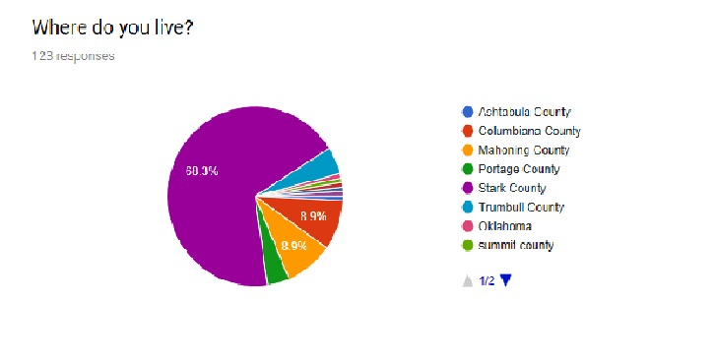
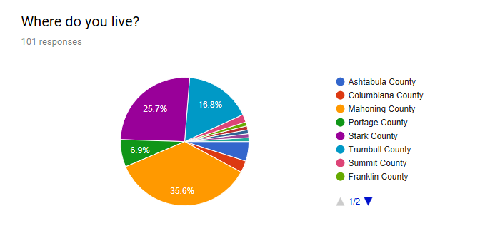
Catholic Teen Responses:
Catholic Young Adult Responses:

Slide 7
Question 1:
Do you feel like the
Church LISTENS to
Young people?
What percentage of TEENS,
YOUNG ADULTS
PARENTS/FAMILIES
Feel like the Church DOES a good job
of listening to young people?

Slide 8
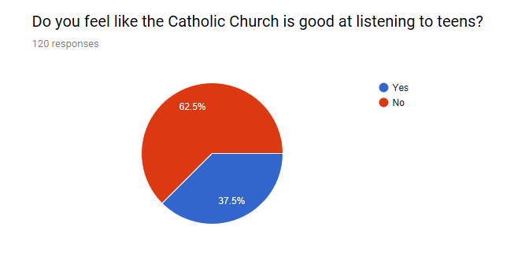

Slide 9
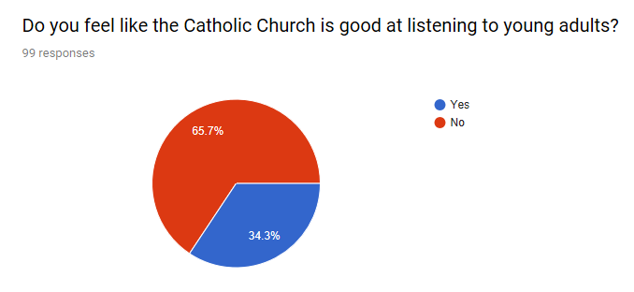

Slide 10
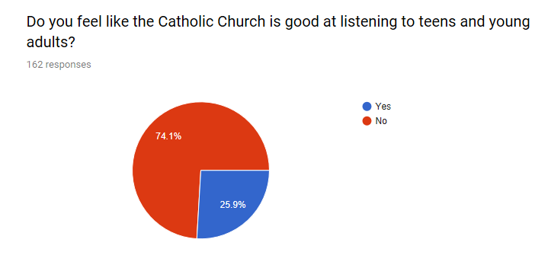
From Parents/Family members surveys:

Slide 11
RE: LISTENING:
A common positive response was there was youth ministry at the parish or listed some youth ministry activities (45), although few of these responses specifically mentioned listening to teens.
10 responded youth active in liturgical roles, but again not tied specifically to listening to youth.
8 responses included the participation of youth on Parish Council, which would imply listening to youth as one aspect.
41 responses focused on a person that was working directly with the youth – youth minister, CCD teacher, priest, or other caring adults. In the building of relationships, key adults are able to connect with the youth on a personal level and listen to their concerns.
Significantly, 11 people cited the pastor or priest as someone who listens to youth.
Many people responded that the leadership of the parish was an important factor for assessing whether or not they felt the parish listened to youth.

Slide 12
Question 2:
What are the
main
Challenges of
Young People
in the diocese today?

Slide 13
Challenges: General
Negative Peer Pressure (40)
Drugs/alcohol (33)
Bullying (12)
Anxiety (12)
School (10)
Young Adults Added Finances, not being treated as Adults, jobs, relationships, sex and lack of community as key challenges.

Slide 14
Challenges: Church/Faith
Church is boring, non-engaging (26)
Staying connected to my faith/the Church (23)
Lacking belief in God (17)
Church is too strict (16)
Lack of parents faith/practice (13)
Sad note: Of Catholic teens,
5 noted not feeling welcomes/loved at Church….
Note: Question just asked what they think are challenges young people are facing, we did not ask about general or Church/faith related, but the responses seemed to cover both.

Slide 15
Question 3: What are the Most Significant Opportunities for Young People in your diocese today?
Top 4 Answers are on the Board
(note: similar things have been grouped together!)

Slide 16
OPPORTUNITIES:
(Top 4 Answers, Grouped)
1. Liturgical Ministries (65) – servers, choir/music ministry, lector, EMHC, sacristan
2. Volunteering/Service (40) – includes mission trips and organized service projects
3. Youth Ministry Programs (26) – includes retreats, add on young adult programs (2)
4. Catechetical Roles (11) - includes CCD aide, VBS, help Children’s Liturgy of the Word

Slide 17
Question 4: What do young people WANT of the Church?

Slide 18
What do teens and young adults want from the Church? “MORE!”
More activities to help grown in faith (23)
Opportunities for fellowship and fun (23)
Supportive groupings (16)
More engaging Mass (14)*
Give us a voice/let us be leaders (tied 10)
More service opportunities (8)
3 commented on wanting more opportunities to learn about vocations….

Slide 19
Question 5: How many teens and young adults have considered a vocation to religious life or the Priesthood?

Slide 20
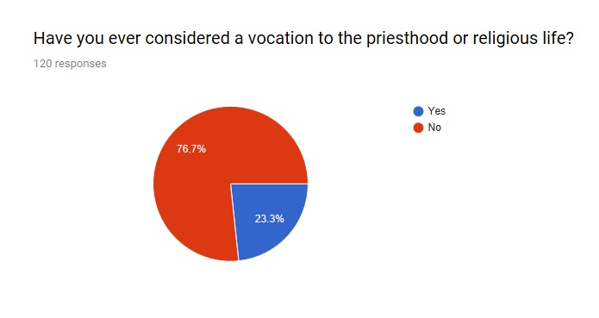
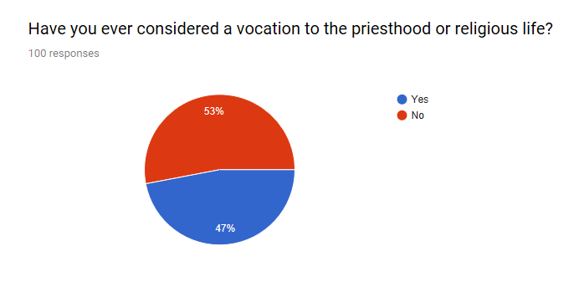
Catholic teens:
Catholic Young Adults:

Slide 21
Question 6 How many of your families discussed religious vocations?

Slide 22
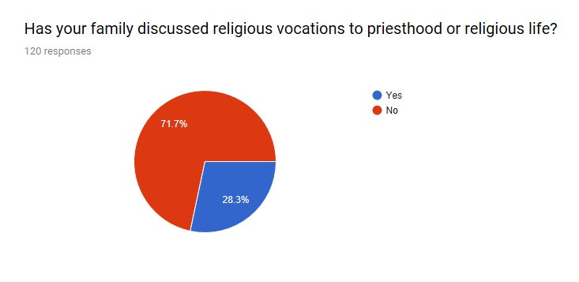
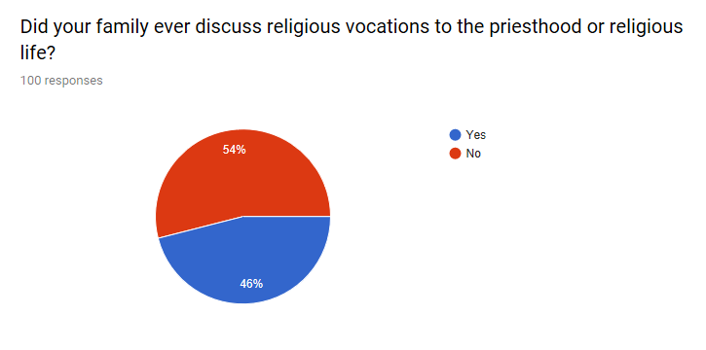
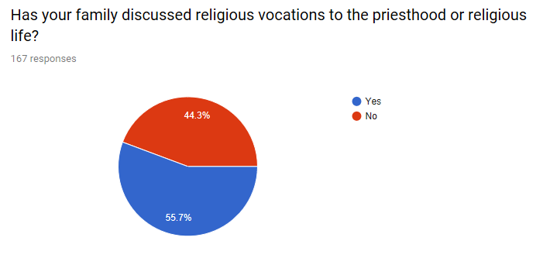
Catholic
Youth
Catholic
Young
Adults
Parents/
Families

Slide 23
Question 7: Has anyone asked you to consider a Religious Vocation (priesthood/religious life)?

Slide 24
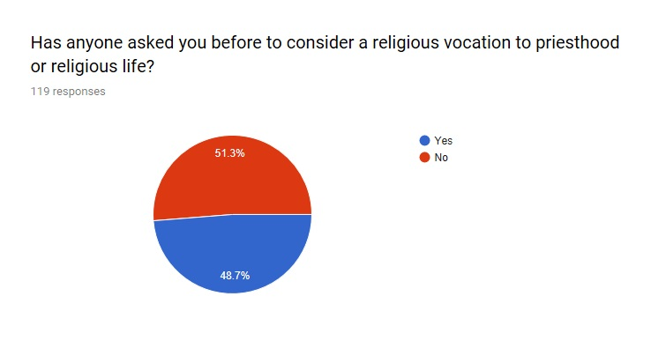
Catholic Teens

Slide 25
Question 8: Have you considered the vocation to marriage?

Slide 26
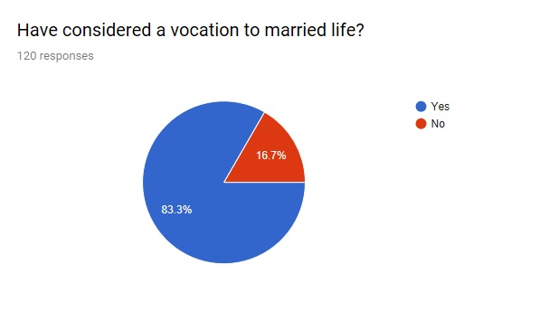
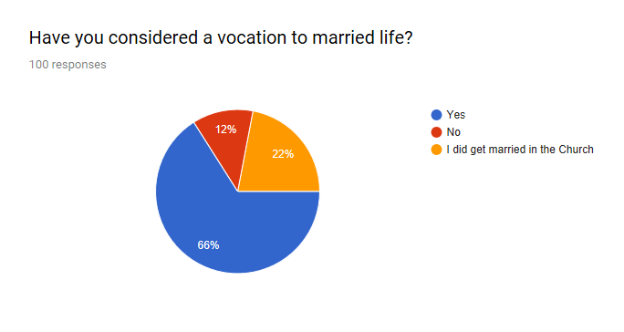
Teens
Young
adults

Slide 27
Question 9: Have you considered a vocation to Lay Ecclesial Ministry?

Slide 28
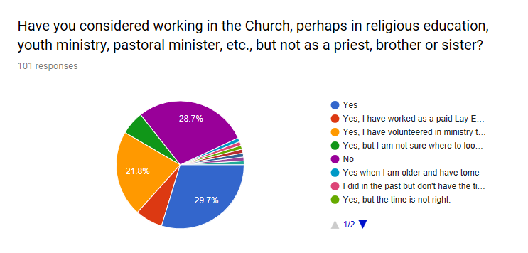

Slide 29
Question 10: For you, So what now?

Slide 30
“the vocational experience is a gradual process of inner discernment and growth in the faith, which leads to discovering the fullness of the joy of life and love, making a gift of oneself and participating in the proclamation of the Good News.”
Preparatory document, page 7

Slide 31
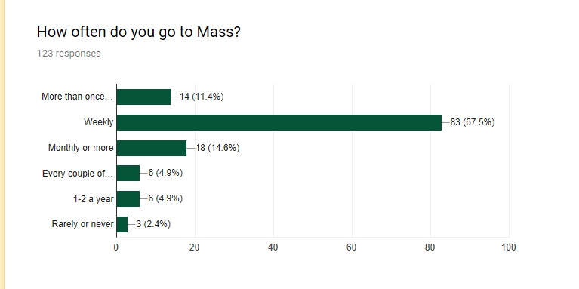
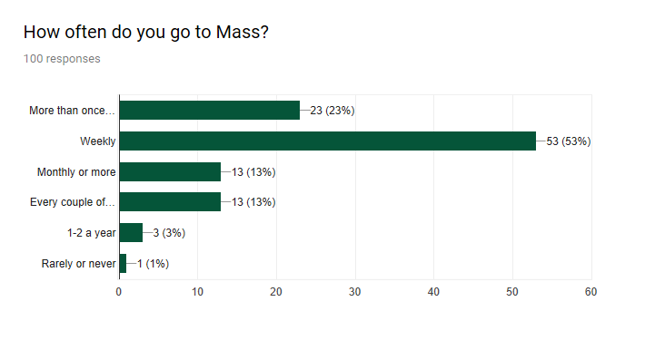
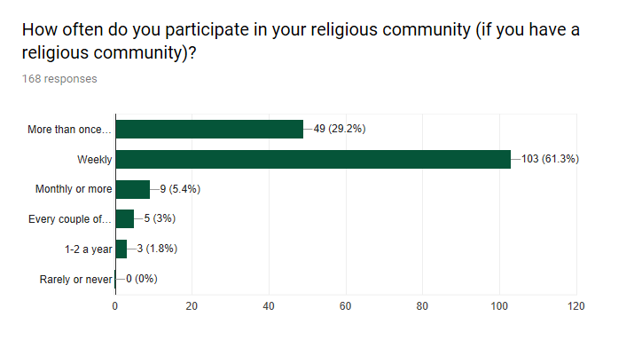
Catholic teens
Catholic Young adults
Parents/
Families

Slide 32
“How does the Church help young people accept their call to the joy of the Gospel, especially in times of uncertainty, volatility and insecurity?
Walking with Young People (Accompanying)
Agents (young people are not objects but agents… connected to responsible community and people of reference
Places (parishes, events, digital connections)
Resources (education, prayer, artistic expressions, etc.)
Mary of Nazareth (Synod dedicated to her, her example and her intercession) “In her eyes every young person can rediscover the beauty of discernment; in her heart every young person can experience the tenderness of intimacy and the courage of witness and mission.” (p. 36)

Slide 33
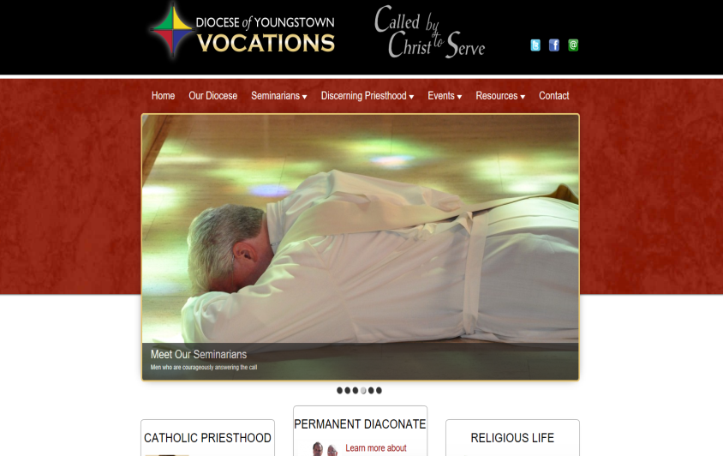
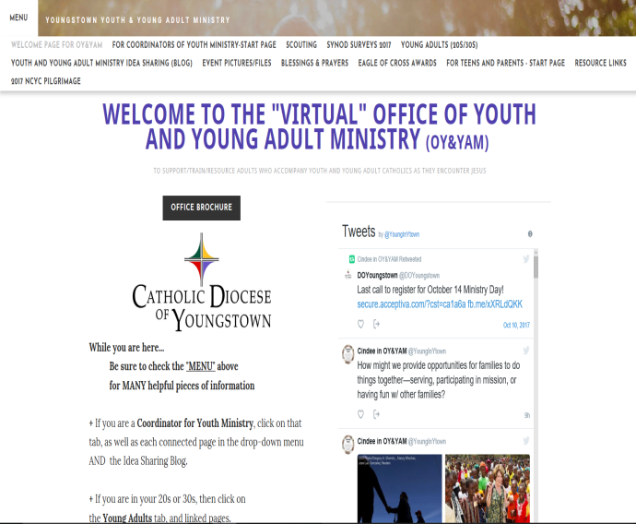
Resources posted on our websites: Office of Vocations: Priesthood, Diaconate, Religious Life https://www.youngstownvocations.org/ and Office of Youth & Young Adult Ministry: High school teens through those 18 – 40 http://youngstownoyyam.weebly.com/

